Slide 1
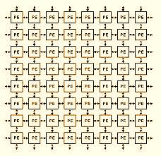
Arrays 1D-Arrays

Slide 2
Objectives
To learn and appreciate the following concepts:
Declare, initialize and access 1D array.
Write programs using common data structures namely arrays and strings and solve problems.

Slide 3
Session outcome
At the end of session student will be able to
Declare, initialize and access 1D array
Write programs using 1D array

Slide 4
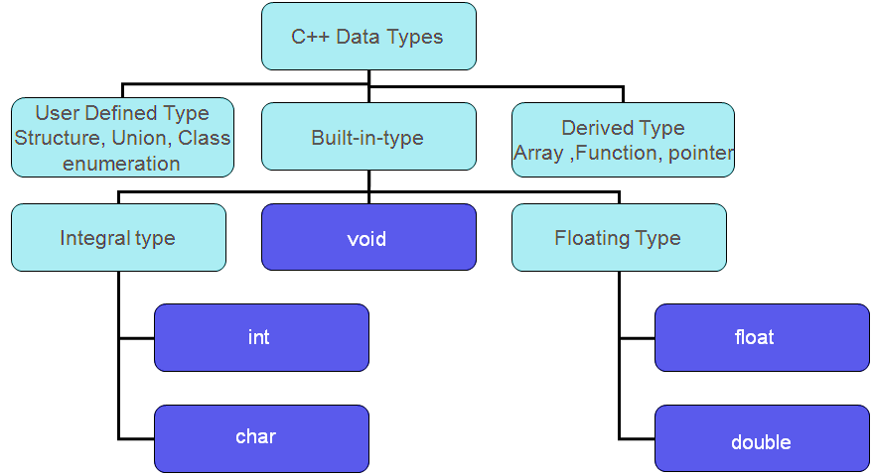
Revisit – Data types

Slide 5
Arrays
An array is a group of related data items that share a common name.
The array elements are placed in contiguous memory locations.
A particular value in an array is indicated by writing an integer number called index number or subscript in square brackets after the array name.
The least value that an index can take in array is 0..
Notes:
Array: C++ provides a data structure, the array, which stores a fixed-size sequential collection of elements of the same type. An array is used to store a collection of data, but it is often more useful to think of an array as a collection of variables of the same type. Instead of declaring individual variables, such as number0, number1, ..., and number99, you declare one array variable such as numbers and use numbers[0], numbers[1], and ..., numbers[99] to represent individual variables. A specific element in an array is accessed by an index. All arrays consist of contiguous memory locations. The lowest address corresponds to the first element and the highest address to the last element.

Slide 6
Arrays
Array Declaration:
data-type name [size];
where data-type is a valid data type (like int, float, char...)
name is a valid identifier
size specifies how many elements the array has to contain.
size field is always enclosed in square brackets [ ] and takes static values.
For example an array salary containing 5 elements is declared as follows
int salary [5];
Notes:
For example
We define an array named salary to represent a set of salaries of a group of employees.
Now the values or the salaries of employees
can be stored as follows.
salary[0]=10000, salary[1]=15000,
salary[2]=20000, salary[4]=10000,…..etc.
where salary[0], salary[1], salary[2]… etc. respectively represent the salaries of first, second, third employee.
After initializing an array, its elements are counted from left to right. Each element of the array, also called a member of the array, has a specific and constant position. The position of an item is also called its index. The first member of the array, the most left, has an index of 0. The second member of the array has an index of 1. Since each array has a number of items which can be specified as n, the last member of the array has an index of n-1
This is a single-dimension array ie. with one subscript. Eg. data-type name [size]. . The arraySize must be an integer constant greater than zero and type can be any valid C++ data type. For example, to declare a 10-element array called balance of type integer, use this statement: int balance[10];

Slide 7
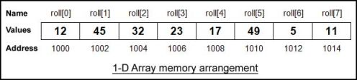
Arrays - One Dimensional
A linear list of fixed number of data items of same type.
These items are accessed using the same name using a single subscript. E.g. roll[0], roll[1]…. or salary [1], salary [4]
A list of items can be given one variable name using only one subscript and such a variable is called a single-subscripted variable or a one- dimensional array.
Notes:
A subscript can be integer constants, Integer variables like i, or expressions that yield integers.
Subscript of subscript is not allowed.
The Maximum subscript value appearing in a program for a subscripted variable should not exceed the declared one.
The subscript value ranges from 0 to one less than the maximum size. For example, If the array size is 5 , then the first subscript is 0, the second is 1 and so on the last subscript is 4. In general i^{th} element has subscript (i-1).

Slide 8
Arrays - 1D
Total size:
The Total memory that can be allocated to 1Darray is computed as
Total size =size *(sizeof(data_type));
where size→ number of elements in 1-D array
data_type→ basic data type
sizeof()→ is an unary operator which returns the size of data type in bytes.
Notes:
The sizeof operator yields the size of its operand with respect to the size of type . When the sizeof operator is applied to an object of type char, it yields 1. When the sizeof operator is applied to an array, it yields the total number of bytes in that array. One of the advantages of the sizeof operator used to get the number of members of the array and it can be used on a for loop to scan an array, either to locate the members or to look for a value in the array.

Slide 9
Arrays - 1D
How to read & display the values of an array and store it !
int main() {
int arr[50],n; // declaration of ‘arr’
printf(" enter value of n\n“); // no of elements
scanf(“%d”, &n); // reading the limit into n
for(int i=0;i<n;i++)
{
scanf(“%d”,&arr[i]); // reading n elements
}
for(int j=0; j<n;j++) //displaying n elements
{
printf(“%d”,arr[j]);
printf(“\t”);
}
return 0;
}

Slide 10
Initializing one-dimensional array
int number[3] ={0,0,0}; or {0} ;
→ declares the variable number as an array of size 3 and will assign 0 to each element.
int age[ ] ={16,25,32,48,52,65};
→ declares the age array to contain 6 elements with initial values 16, 25, 32, 48, 52, 65 respectively

Slide 11
Initialize all the elements of an integer array ‘values’ to zero
Initializing one-dimensional array
int values[20];
Begin for loop
Initialize counter
Set limit for counter
i<20;
i++
int i=0;
for ( )
Initialize element in array ‘values’
values[i]=0;
Increment counter

Slide 12
Printing one-dimensional array
For example
int x[3] = {9,11,13};
printf(“%d\n”,x[0]);
printf(“%d\n”,x[1]);
printf(“%d\n”,x[2]);
Output:
9
11
13
or
int x[3] = {9,11,13};
for (int i = 0; i<3; i++)
printf(“%d\n”,x[i]);

Slide 13
Program to read n elements into an array and print it
int a[10], i, n;
printf("enter no of numbers“);
scanf(“%d”,&n);
printf(“enter n numbers \n”);
for(i=0;i<n;i++)
scanf(“%d\n”, &x[i]);
printf(“\nNumbers entered are:\n”);
for(i=0;i<n;i++)
printf(“%d\n”, a[i]);
Output:
enter no of numbers
3
enter n numbers
9
11
13
Numbers entered are:
9
11
13

Slide 14
Program to add two array elements and store the corresponding sum elements in another array
int a[10], b[10], c[10],n, m, i;
printf("enter no. of numbers in first array\n“);
scanf(“%d”,&n);
//first array reading
for(i=0;i<n;i++)
scanf(“%d”,&a[i]);
printf("enter no of numbers in second array\n“);
scanf(“%d”,&m);
//second array reading
for(i=0;i<m;i++)
scanf(“%d”,&b[i]);
if(m==n)
{ //addition
for(i=0;i<m;i++)
c[i]=a[i]+b[i];
printf(“Sum of given array elements\n”);
for(i=0;i<n;i++)
printf(“%d\n”,c[i]);
}
else
printf("cannot add“);
}

Slide 15
Displaying elements of an array in reverse order.
int a[10], n, i;
printf(“Enter values\n“);
for(i=0;i<n;i++)
scanf(“%d”, &a[i]);
printf(“\nReverse order printing of array\n”);
for(i=n-1;i>=0;i--) // reverse loop
printf(“%d\n”, a[i]);
Example : a[ ]={1, 2, 3, 4, 5}
Enter values
n=5
1 2 3 4 5
Reverse printing of array
5 4 3 2 1
Array before Array after
a[0]=1 a[0]=1
a[1]=2 a[1]=2
a[2]=3 a[2]=3
a[3]=4 a[3]=4
a[4]=5 a[4]=5

Slide 16
Write a program to reverse an array using only one array
int a[20], i, j, n, temp;
printf("enter n \n“);
scanf(“%d”, &n);
printf("\n Enter values for an array“);
for(i=0;i<n;i++)
scanf(“%d”, &a[i]);
Example : a[ ]={1, 2, 3, 4, 5}
Enter values
n=5
1 2 3 4 5
Reversed array
5 4 3 2 1
Array Reversed array
a[0]=1 a[0]=5
a[1]=2 a[1]=4
a[2]=3 a[2]=3
a[3]=4 a[3]=2
a[4]=5 a[4]=1
Contd…

Slide 17
Reversing an array
Example :
a[ ]={1, 2, 3, 4, 5}
for(i=0, j=n-1; i<n/2; i++, j--)
{
temp=a[i];
a[i]=a[j];
a[j]=temp;
}
printf("\n Reversed array: \n“);
for(i=0;i<n;i++)
printf(“%d\t”, a[i]);
}
for(i=0; i<n/2; i++)
{
temp=a[i];
a[i]=a[n-i-1];
a[n-i-1]=temp;
}
printf("\n Reversed array: \n“);
for(i=0;i<n;i++)
printf(“%d\t”, a[i]);
}
Output:
Enter values for an array
n=5
1 2 3 4 5
Reversed array
5 4 3 2 1
Array Reversed array
a[0]=1 a[0]=5
a[1]=2 a[1]=4
a[2]=3 a[2]=3
a[3]=4 a[3]=2
a[4]=5 a[4]=1

Slide 18
WAP to insert an element to an array at a given position
int a[100], n,i, pos, ele;
scanf(“%d”,&n); // number of elements
printf("\nEnter the elements of array:“);
for(i=0;i<n;i++)
scanf(“%d”,&a[i]);
printf("\nEnter the element and position of insertion:“);
scanf(“%d %d”,&ele,&pos);
for(i=n; i>=pos; i--) //shift the elements to right
a[i]=a[i-1];
a[pos-1] = ele; //ele is inserted at the specified pos.
n = n + 1; // increment the count of no of elements
printf("\nThe array after insertion is:“);
for(i=0;i<n; i++) printf(“%d\n”,a[i]);
Example : insert 9 at 2nd position
a[ ]={1, 2, 3, 4, 5}
New array after inserting 9 :
a[ ]={1, 9, 2, 3, 4, 5}

Slide 19
WAP to delete an element from an array
printf("enter no of numbers“);
scanf(“%d”,&n);
printf("enter n numbers \n“);
for(i=0;i<n;i++)
scanf(“%d”,&a[i]);
printf("enter the position at which the element to be deleted“);
scanf(“%d”,&pos);
for(i=pos-1; i<n-1; i++)
a[i] =a[i+1]; //shift the elements to left
n = n-1; //decrement the count of no of elements
for(i=0;i<n;i++)
printf(“%d”,a[i]);
Example : delete ele at 2nd position
a[ ]={1, 2, 3, 4, 5}
New array after deleting 2:
a[ ]={1, 3, 4, 5}

Slide 20
Insert an element into a sorted array
Read array elements (in sorted order) & element ‘ele’ to be inserted
//finding position
for(i=0;i<n;i++)
if (ele<a[i])
break;
pos = i+1; //position of insertion
for(i=n; i>=pos; i--) //shift the elements to right
a[i]=a[i-1];
a[pos-1] = ele; //ele is inserted at the specified pos.
n = n + 1; // increment the count of no of elements
Example: insert 3 into the array
a[ ] = {1, 2, 4, 5, 6}
New array after inserting 3 :
a[ ] = {1, 2, 3, 4, 5, 6}

Slide 21
1 Dimensional Arrays
1D Array:
Syntax: type array_name[size];
Memory Requirement:
Total size =size *(sizeof(data_type));
Initialization:
type array-name [size]={list of values}
Write and Read:
for(i=0;i<n;i++) for(i=0;i<n;i++)
scanf(“%d”,&a[i]); prinft(“%d\n”,a[i]);

Slide 22
Tutorials on Array
Write a program to find average of an 1-D array.
Write a program to find second largest element in an array.
Write a program to find union and intersection of two arrays.

Slide 23
Summary
Arrays
1 Dimensional arrays (lists)
Problems on 1D arrays

Slide 24
/* largest and second largest element in an array*/
largest1 = array[0];
/* assume first element of array is the second largest */
largest2 = array[1];
for (i = 1; i < MAX; i++)
{
if (array[i] >= largest1)
{
largest2 = largest1;
largest1 = array[i];
}
else if (array[i] > largest2)
{
largest2 = array[i];
}
}
Example: array[ ] = {22,44, 34, 9, 21}
44 is largest
34 is second largest

